Slide 1
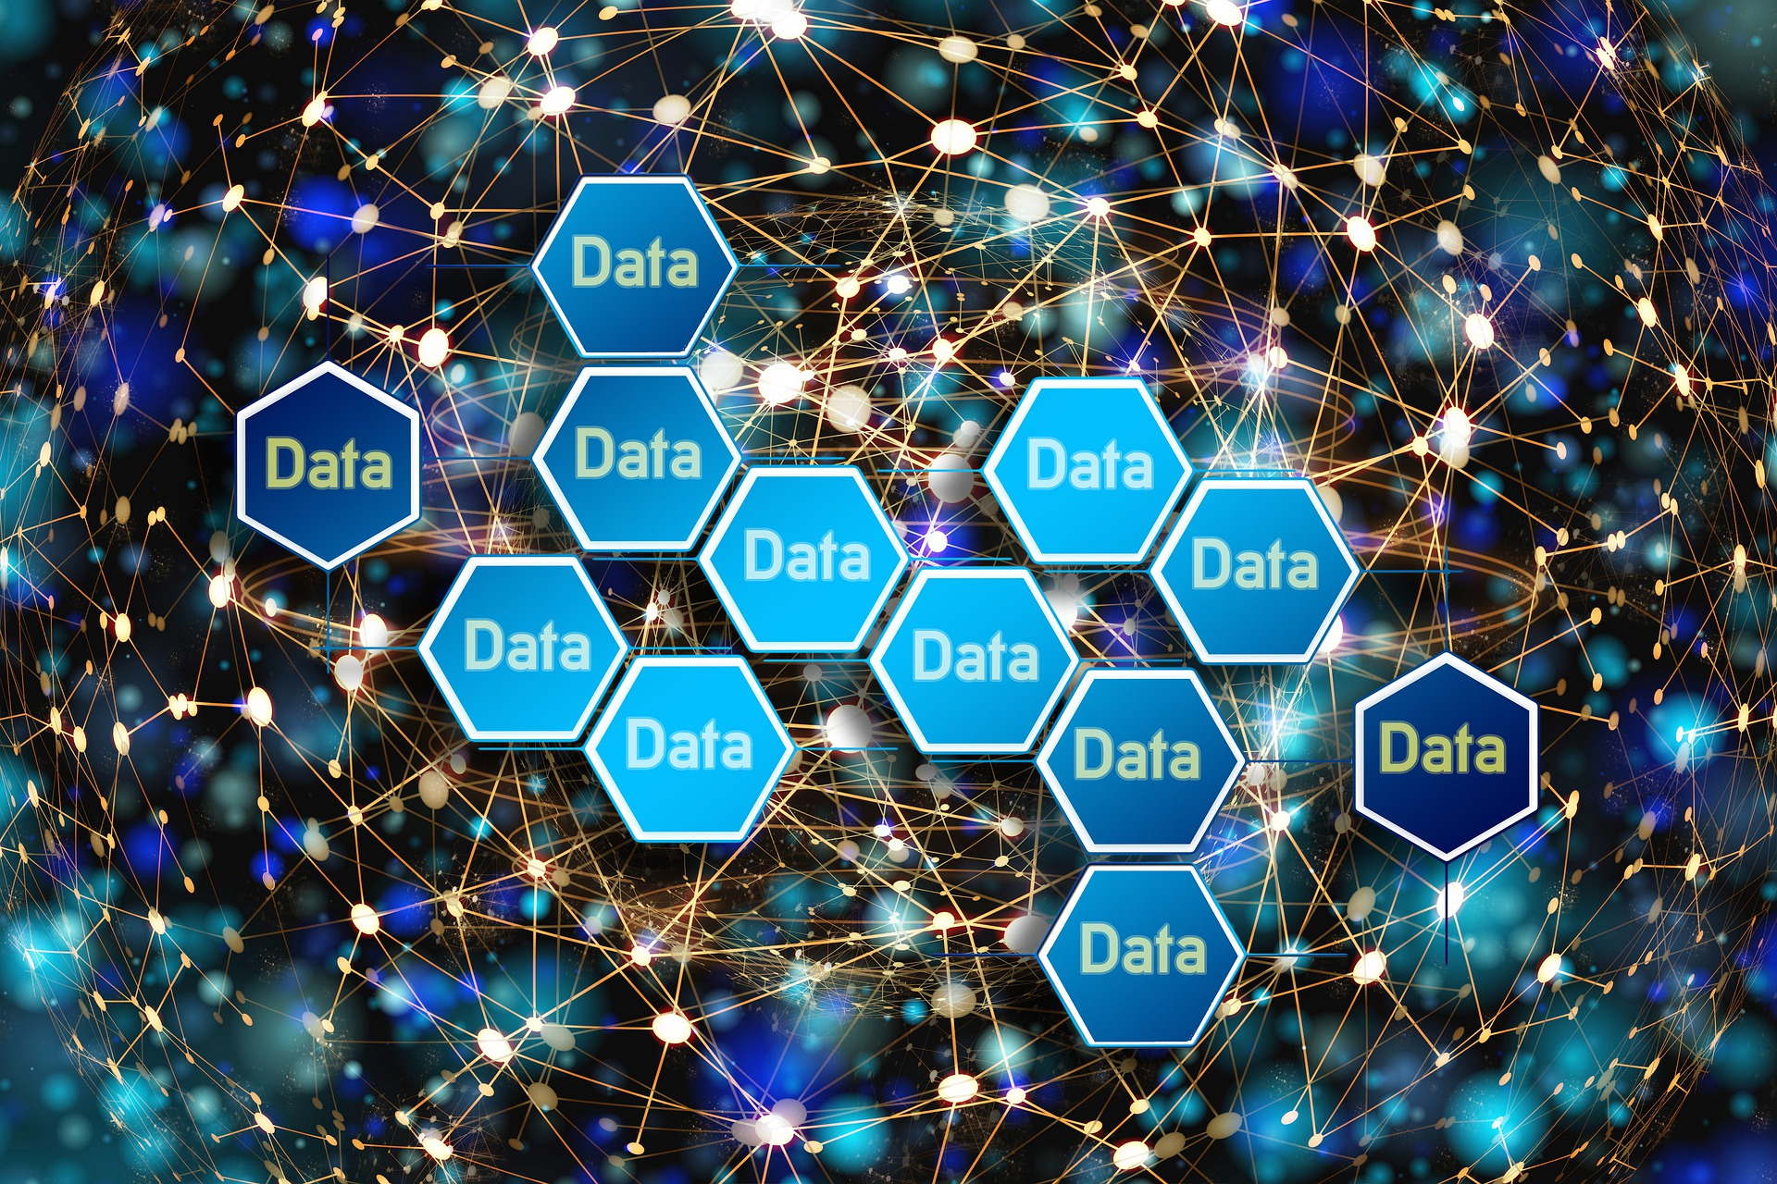
Data Collection for Machine Learning
25/04/2023
Avv. Chiara Gallese Nobile, Ph.D., CIPP/E
University of Trieste, LIUC University, Eindhoven University of Technology
Eindhoven University of Technology

Slide 2
Outline
- Introduction: data collection for machine learning
Basic principles of Data Protection
Basic principles of AI Auditing
Basic principles of AI Ethics
The new AI Act proposal
Applying ethical principles to data sets: practical examples
Conclusion
Q&A

Slide 3
INTRODUCTION
WHY THIS COURSE?
You will be able to:
Understand data collection practices
Recognize applicable laws and regulations
Recognize ethical principles related to AI
Apply theoretical principles in practice
Avoid sanctions and reputational damage

Slide 4
RECENT LAWSUIT & SANCTION CASES
IBM
ClearviewAI
ChatGPT
What did they do wrong?

Slide 5
WRONG DATA COLLECTION!
Data Scraping
Information
Data use
Scraped the web collecting images, code and texts without consent
Did not provide information about their practices
Used copyrighted materials and personal data without authorization

Slide 6
IBM
Allegedly scraped the web to collect random people images

Slide 7
CLEARVIEW AI
Used innocent people faces to train their AI system aimed at recognizing criminals in public spaces by Law Enforcment Authorities

Slide 8
OPEN AI
Scraped the web to indiscriminately collect personal data and copyrighted material

Slide 9
…AND MORE

Slide 10
WHY COULDN’T THEY COLLECT PUBLICLY AVAILABLE DATA?
COPYRIGHT LAWS. «Publicly available» does not equal to «public domain». Trademarks, logos, databases, and copyrighted materials are still protected by law even if they are accessible to the public on a website.
DATA PROTECTION LAWS. Personal data of living persons are still protected by privacy laws even if they are available online.
WEB SCRAPING LAWS. In some countries, such as Europe, web scaping is regulated.
CONTRACT LAWS. Each website has different contractual rules.
ETHICS. There are some ethics rules that prevent from stealing images without consent, whitout information, and for detrimental uses.

Slide 11
COPYRIGHT LAWS

Slide 12
DATA PROTECTION LAWS
CONVENTION 108+ (55 Countries)
GDPR (the whole EU)
NATIONAL LAWS (each country) India: Digital Personal Data Protection Bill (the DPDP Bill) expected in 2023
NAMES AND OTHER INFORMATION IN WEBSITES ARE STILL PROTECTED BY DATA PROTECTION LAWS!

Slide 13
THE DATABASE DIRECTIVE
NOT AI TRAINING
In the case between Ryanair and the websites Volagratis and Lastminute, scraping activity to provide comparison in tickets prices was deemed lawful by the Court of First Instance, the Court of Appeal of Milan, and the Civil Cassation insofar as copyright protection of the information contained on Ryanair's site was excluded, since “the organization of the data is inspired by management purposes and performs functions of information on the products of the company that manages the site, without an appreciable degree of creative intellectual contribution”. The sui generis right was excluded as well, because, according to the judge, the fact that Ryanair granted the right to extract its data for a ‘symbolic’ price of €100.00 would demonstrate not the wish to protect such data, but rather the aim of preventing third parties from marketing its flights.

Slide 14
WEB SCRAPING LAWS 1
NOT AI TRAINING
EU LAW: Directive (EU) 2019/790 on copyright and related rights in the Digital Single Market (‘DSM Directive’), Article 4, provides an exception from copyright ONLY for “reproductions and extractions of lawfully accessible works and other subject matter for the purposes of TEXT AND DATA MINING*”, except where “the use of works and other subject matter referred to in that paragraph has not been expressly reserved by their rightholders in an appropriate manner, such as machine-readable means in the case of content made publicly available online”.
* automated computational analysis of information in digital form

Slide 15
WEB SCRAPING LAWS 2
US LAW: In 2021, the Supreme Court decision Van Buren v. United States stated that scraping publicly available internet information isn’t criminalized by the federal computer crime law.
In the long legal battle between LinkedIn Corp. and hiQ Labs Inc., a California District Court in 2017 and Ninth Circuit panel in 2019 first ruled in favor of the latter.
See the case description and links to relevant documents in the article on the National Law Review at the following link: https://www.natlawreview.com/article/hiq-and-linkedin-reach-proposed-settlement-landmark-scraping-case

Slide 16
LINKEDIN CORP. v. HIQ LABS INC.
HiQ Labs was a small company that began scraping public profile data and data restricted to registered users from LinkedIn users in order to create a business analytic service. HiQ Labs filed a declaratory judgment request for a preliminary injunction after receiving a cease-and-desist letter from LinkedIn demanding that hiQ discontinue its scraping activities. The case went to the Supreme Court, which granted LinkedIn's petition for certiorari and returned the matter to the Ninth Circuit for further consideration. In April 2022, the Ninth Circuit upheld the lower court's preliminary injunction in favor of hiQ, however, in October of the same year, a California District Court ruled in favor of LinkedIn. This most recent ruling is noteworthy since it primarily addresses contract liability for violating a website's user agreement and its restrictions on scraping, as well as making fraudulent accounts.

Slide 17
RYANAIR DAC v. BOOKING HOLDINGS INC. 1
In Ryanair DAC v. Booking Holdings Inc. the famous travel company allegedly acquired information by scraping the ticketing portion of the Ryanair website. According to Ryanair, the action of the defendant violated the Computer Fraud and Abuse Act (CFAA).
The Court held that ``In order for the CFAA’s “without authorization” and “exceeds authorized access” elements to apply, some sort of authentication mechanism (e.g., the use of usernames and passwords) must be employed to limit access to the website. If the information on the website is publicly available without requiring users to authenticate themselves, a violation of the terms of use or the defiance of a cease-and-desist letter will not give rise to liability under the CFAA".

Slide 18
RYANAIR DAC v. BOOKING HOLDINGS INC. 2
However, the Court also noted that ``Ryanair also alleges that the defendants engaged in screen scraping in violation of the terms of use of the Ryanair website and that the defendants continued to do so even after Ryanair sent each defendant a cease-and-desist letter. Although those allegations would be insufficient to establish liability under the CFAA if the contents of the myRyanair portion of the website were accessible to the public without authentication, courts have found cease-and-desist letters to withdraw authorization to access a protected portion of a website when an authentication mechanism protected access to that portion of the website".

Slide 19
CONTRACT LAWS
EU LAW: contract laws differ depending on the single Member States’ law.
US Case law: see the cases mentioned in the previous slides
India Law: electronic contracts are valid and enforceable and violating a contract that prohibits data scraping could be a violation of contract law. It also might violate section 43 of the Information Technology Act, enacted in 2000, which prohibits unauthorized access to a computer resource or extracting data from a computer resource.
The general rule is that web scraping can be limited by a contractual clause. However, as we have seen in the Italian Ryanair case, exceptions apply for specific purposes.

Slide 20
PUBLIC DOMAIN DATA
Some digital objects or data are not covered by copyright laws, such as:
Mere facts
Works whose copyright expired
Works whose license allows its use as public domain data (CC0)
Works that have no creative intellectual content

Slide 21
ILLICIT CONTENT
Sometimes, we can find online some illicit content, such as stolen data, pornographic materials involving minors of non-consenting individuals, information about terrorist activities, and such.
When performing web scraping to train AI system, it is extremely important to exclude this material, as the mere possession might be considered a criminal offence.

Slide 22
ETHICS
EU GUIDELINES: AI HLEG Trustworthy AI Guidelines
INTERNATIONAL GUIDELINES:
Universal Guidelines for AI (2018)
OECD AI Principles (2019)
G20 AI Guidelines (2019)
UNESCO Recommendation on AI Ethics (2021)

Slide 23
DATA SET FAIRNESS 1
What is data set fairness?
Research has shown how data sets convey social bias in AI systems, especially those based on machine learning. A biased data set is not representative of reality and might contribute to perpetuate societal biases within the model. To tackle this problem, it is important to understand how to avoid biases, errors, and unethical practices while creating the data sets.

Slide 24
DATA SET FAIRNESS 2
What is data set fairness?
Mainstream works in computer science addresses the problem of fairness in a context of prediction-based decisions. Usually, mathematical definitions requires achieving parities across distributions of outcomes or scores (common examples include statistical parity and calibration). Definitions can refer to individuals (e.g., requiring that similar individuals are treated similarly) or groups (e.g., requiring that any error measure is equal across groups, defined by so-called protected characteristics like gender or race).
Mathematical definitions can reflect philosophical conceptualisations, such as the equality of outcomes and the equality of opportunities. In general, computer science literature expresses in empirical and formal terms philosophical problems of distributive justice in which the goal of fairness is to achieve an equal allocation of goods.

Slide 25
DATA SET FAIRNESS 3
What is data set fairness?
The concept of fairness is frequently found also in text of law and it has been extensively analysed by the legal scholarship, having its roots in the "bona fide" concept in Roman law. The fairness principle is an overarching obligation in the European Digital Strategy, for example in Article 5, par. 1, of GDPR, and in the Data Act, but it is also found in the EU and in other countries in many pieces of law, such as Article 8, par. 2, of the Charter of Fundamental Rights of the European Union, contract law, and others.
The data protection law scholarship divide the fairness principle into two elements, procedural fairness and fair balancing, noting that the concept of fairness is related to the idea of vulnerability. The GDPR aims at protecting data subjects, who are in a vulnerable position as opposed to data controllers, therefore it tries to make a balance between the fundamental rights and freedoms of the former and the interests of the latter.

Slide 26
FAIRNESS ASSESSMENT OF DATA SETS
So far, the assessment of algorithmic fairness in the context of data has followed two main directions. A research track regards the analysis of data curation processes or the development of new documentation frameworks. Recently, Fabris et. Al annotated hundreds of data sets employed in algorithmic research efforts specifying key fairness-related characteristics (e.g. the domain of application, the target task and the sensitive attributes encoded in the data set) in order to address the so-called “documentation debt”.
Another direction focuses on the empirical analysis of fairness-related data dimensions.
These efforts include pre-processing techniques such as sanitization and instance re-weighting and procedures evaluating distinct sources of discrimination in data collection or studying the effect of data-related factors on the fairness of algorithms.

Slide 27
OUR WORK

Slide 28
FANFAIR AIMS
Our work moves along the line of empirical research with some important distinctions. The fairness-related features we explore are agnostic about the sensitive attribute in that they capture essential vulnerabilities that may contribute to model (un)fairness.
Another distinct aspect of our approach is to integrate statistical information about the data sets (balance, numerosity, unevenness, incompleteness) with qualitative considerations (compliance, quality) which take into account legal and ethical requirements of data-related practices (e.g. GDPR, principles of research integrity). This integration is operated through the application of fuzzy rule-base logic and reflected in a score that can be indicative of the fairness potentially introduced by a given data set.

Slide 29
FANFAIR DEFINITION OF FAIRNESS
Although in our paper we take into consideration GDPR, we do not limit the concept of (legal) fairness to data protection law, but we expand the notion to other areas of law, including the non-discrimination principle, that is found, inter alia, in the European Convention of Human Rights, the equity principle, and the bona fide principle in contractual agreements.
In our opinion, a data set which data collection has been flawed by discrimination or another breach of the law (e.g., copyright law, criminal law, medical law) cannot be considered fair.
The lawfulness criteria is also in line with the High-Level Expert Group on AI (HLEG AI)'s guidelines on Trustworthy AI.

Slide 30
1. BASIC PRINCIPLES OF DATA PROTECTION

Slide 31
SOURCES OF LAW
GDPR is not the only law applicable to data protection. There are also international conventions, national laws, Constitution, EU treaty, and other sources of law. Legal instruments are arranged hierarchically.

Slide 32
SOURCES OF LAW
…implemented differently in each Member State

Slide 33
MATERIAL AND TERRITORIAL SCOPE
GOALS:
Protecting personal data of natural persons
Facilitating the exchange of data within the EU
GDPR DOES NOT APPLY TO:
Personal or household activity
Competent authorities for criminal offences or criminal penalties
EU bodies, offices, agencies
GDPR APPLIES TO:
Data Controller or processor established in the EU
Activities targeting of subjects located in the EU
Competent authorities for purposes other than law enforcement
(Data Subject’s nationality does not matter)

Slide 34
GDPR basic principles - DEFINITIONS
Personal data
Processing
Regardless of the format
(mathematical form too)

Slide 35
Biometric data (photos, MRI scans, voice, and video recording)
Genomic expression information
Profiling (any habits, personality tests, work assessment, preferences)
Identifiers (nickname, cookies, browser settings)
Location data (GPS, ZIP code)
Opinions (religious believes, political opinion)
Feelings (burnout information, mood information)
Income, debt and borrower reliability information
Data directly or indirectly related to a natural person, such:

Slide 36
DATA COLLECTION IS A FORM OF DATA PROCESSING
Web scraping
Text mining
Receiving data from third parties
Performing interviews, focus groups, surveys
Making experiments and clinical analysis
Analyzing samples
Online tracking
GPS monitoring
Collecting data from IoT

Slide 37
Collecting and Recording data
Storing, uploading and archiving data
Modifying, Analyzing and Deleting data
Using data to create something else (e.g., images, tables)
Sharing, disseminating, or making data available otherwise
Organizing or structuring data
Reading or looking at the data
Using data to communicate (e.g., sending emails)
Changing the format or the size of data
Using data to train a model
Accessing data through VPN
Data processing includes:

Slide 38
DATA PROCESSING EXAMPLES IN MACHINE LEARNING
Collecting data
Analyzing data
Putting data into a data set
Preprocessing data
Feeding data to train the model

Slide 40
GDPR basic principles – Basic concepts
lawfulness, fairness and transparency
purpose limitation
data minimisation
accuracy
storage limitation
integrity and confidentiality
accountability

Slide 41
LAWFULNESS
Legal basis for processing
Respect of GDPR
Respect of other relevant laws and regulations (national and international)

Slide 42
LAWFULNESS IN MACHINE LEARNING
Make sure you can collect and use the data
Respect the license of the data set
Inform the data subjects about data processing, when needed
Sign the appropriate agreement, when needed
Discard the data you don’t need
Keep the data safe and secure
Delete the data when you do not need it anymore
Document GDPR compliance

Slide 43
FAIRNESS
Consider how it affects the interests of data subject
Consider what the data subject expects
Do not discriminate

Slide 44
FAIRNESS IN MACHINE LEARNING
Perform the legitimate interest assessment (LIA)
Perform the risk assessment
Perform the transfer impact assessment (TIA)
Perform the re-use assessment
Perform the data protection impact assessment (DPIA)
Do not use data to harm data subjects

Slide 45
TRANSPARENCY
Record of activities
Privacy notice/policy
Right to access

Slide 46
PURPOSE LIMITATION
Ask questions
Perform market analysis
Personal data must be used only for lawful purposes
Controller must communicate all purposes to data subjects
Further purposes must be compatible with the original ones
Send information
Send invoices
Sell data to other companies
Profile perspective clients
Marketing

Slide 47
DATA MINIMIZATION
Data of all ICU patients 2010 -2021
Data related to all ICU admissions during 2020
Data related to ICU admissions in Milan during 2020
Data that can be used
Only data strictly necessary for each purpose can be collected, used and shared
It is not possible to collect data «just in case» they may be useful in the future
While choosing data, other laws and code of conduct must be considered
Do you need to analyze COVID-19 ICU admissions in Milan during 2020?

Slide 48
2021 Conference
ACCURACY
Here it is our next speaker, Dr. Caia:
Personal data must be correct
Personal data must be updated
Data that are not correct or updated must be deleted
Dr. Caia in 1982
Dr. Caia in 2021

Slide 49
STORAGE LIMITATION
Personal data must be kept only for the time strictly necessary for each purpose
After the retention time has expired, data must be deleted
If data must be kept longer for one purpose, data still cannot be used for different purposes
LEGAL DEPARTMENT ONLY

Slide 50
INTEGRITY AND CONFIDENTIALITY
Personal data must be kept safe
Cyber security measures must be implemented
Only authorized people can access the data

Slide 51
ACCOUNTABILITY
Controller is responsible for compliance
There are no minimum requirements, Controller must assess the risks
Controller must demonstrate that everything was done in compliance with GDPR
GDPR LIST

Slide 52
LEGAL BASIS
Law, regulations, decrees, ordonnances, Court orders
Contract
Consent
Legitimate interest
Public interest
Protecting vital interests
LED Directive

Slide 53
LEGAL BASIS IN AI
LEGITIMATE INTEREST (research, further use of public data sets)
CONSENT
PUBLIC TASK (train models for law enforcement)
In clinical trials, see: https://ec.europa.eu/health/sites/default/files/files/documents/qa_clinicaltrials_gdpr_en.pdf

Slide 54
CAN YOU REUSE SOMEONE ELSE’S DATA SET?
It depends on the specific circumstances. You must assess if the lawful conditions are met:
Do the other party have the right to give you their data? If not, it is illegal to use the data set
Do you need an agreement to transfer the data?
What is your legal basis?

Slide 55
CONSENT
Different from ethical Informed consent
Must be freely given, specific, informed and unambiguous
For special categories of data, for transfer abroad, and for automated decision making and profiling, it must be also explicit

Slide 56
WHITDRWAL OF CONSENT
WHITDRAWAL OF CONSENT
Data subject has the right to withdraw consent at any time. If it happens, the data processing must be stopped.
The withdrawal is valid only for future processing, and what has been done before remains lawful.

Slide 57
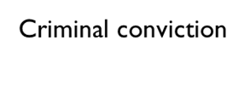
Special CATEGORIES OF DATA
Health
Ethnicity
Sexual orientation or gender identity
Religious or philosophical beliefs
Political opinions or Trade Union
Genetic
Social security number
Biometric

Slide 58
HEALTH DATA
Physiological measurements (blood pressure, blood analysis, muscles performance)
Psychological state of mind (burnout, mood)
Neurodiversity information (ADHD, Asperger, Dyscalculia, Dyslexia, Non-verbal disorder, etc.)

Slide 59
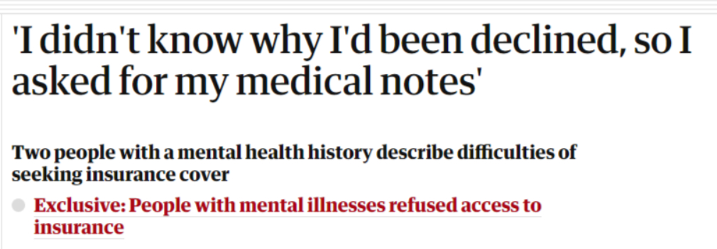
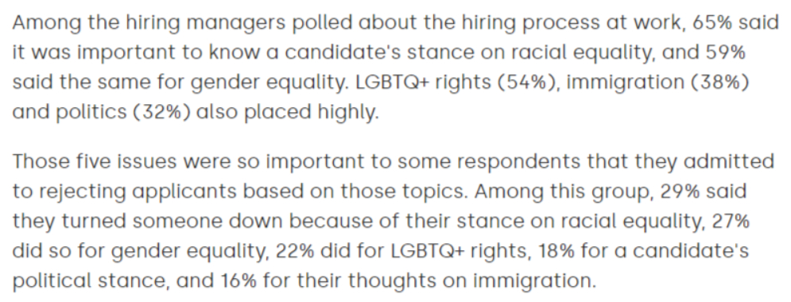
WHY ARE special DATA DIFFERENT from other types of data?
If made public, the consequences may be severe
Personality tests used in the hiring process have consistent patterns of correlations with sociodemographics
Elleman, Lorien G., et al. "The personality of US states: Stability from 1999 to 2015." Journal of Research in Personality 72 (2018): 64-72.

Slide 60
Data Controller
Data Controller
Joint Data controllers
Legal person, public authority, agency or other body which determines the purposes and means of the processing of personal data
Two or more legal persons, public authorities, agencies or other bodies who share and decide the purposes and means of processing

Slide 61
WHEN ARE YOU A DATA CONTROLLER?
When you collect data
When you receive data, and you use it for your own purposes
When you are a processor, and you use data against the Controller’s instructions

Slide 62
Processor
Natural or legal person, public authority, agency or other body which processes personal data on behalf of the Data Controller
Provides sufficient guarantees to implement appropriate technical and organisational measures
Follows instructions, cooperates, gives notice of Data breaches
Returns or deletes Data

Slide 63
WHEN ARE YOU A DATA PROCESSOR?
When you are paid to perform analysis on data or to train a model for someone else
When you help someone for free and you follow their instructions
When you store data for someone else

Slide 64
Sub-processor
Natural or legal person, public authority, agency or other body which processes personal data on behalf of the Controller after being appointed by the Processor
Follows instructions and cooperates, gives notice of Data breaches
Returns or delete Data
Written authorization by the Data Controller, who can object

Slide 65
DATA AGREEMENTS
They are not independent agreements, there has to be an underlying contract, i.e. a reason why data are transfered between Parties

Slide 66
PRIVACY ROLES
ROLE
Independency
Collaboration
Service

Slide 67
Data Transfer/Sharing Agreement
Between two autonomous Controllers
When each party determines the purpose of the processing separately
There must be a legal basis that allows the transfer
Privacy notice pursuant to art. 14 should be provided at the first contact

Slide 68
Joint Controllership Agreement
Between two joint Controllers
It determines in a transparent manner their respective responsibilities
It duly reflects the respective roles and relationships of the joint controllers vis-à-vis the data subjects
The essence of the arrangement shall be made available to the data subject

Slide 69
Between Data Controller(s) and Processor(s)
A contract or other legal act binding the processor to the controller
It sets out the subject-matter and duration of the processing, the nature and purposes of the processing, the type of personal data and categories of data subjects
It determines specific tasks and responsibilities of the processor
It considers the risk to the rights and freedoms of the data subject
DATA PROCESSING AGREEMENT

Slide 70
Transfer of Data outside the eu
DATA TRANSFER OUTSIDE THE EU
Appropriate safeguards (standard contract clauses, approved code of conduct, international agreements)
Binding corporate rules (intragroup + approved by the authority)
Exceptions (consent, contractual obligation, vital interests)
Adequacy decision

Slide 71
Privacy notices
Art. 13 and 14
Clear language
Simple wording
Adapting to data subject’s level
Translation into data subject’s mother tongue

Slide 72
Privacy notices: WHAT SHOULD I WRITE?
Art. 13 and 14
Name of Controllers, Processors, DPO and source of data
Categories of data
Purposes of processing and further processing
Legal basis
Retention time
Transfer of Data and recipients
ADM and Profiling
Separate consent boxes
Rights of the Data Subjects

Slide 73
Rights of the Data Subjects
Transparency
Access
Rectification
Erasure
Restriction
Portability
Object
Not subject to ADM

Slide 74
derogations
RIGHTS OF THE DATA SUBJECTS
For scientific or historical research purposes or statistical purposes, law may provide for derogations from Articles 15, 16, 18 and 21 if they render impossible or seriously impair the achievement of the specific purposes
For archiving purposes in the public interest, law may provide for derogations from Articles 15, 16, 18, 19, 20 and 21 if they render impossible or seriously impair the achievement of the specific purposes
Art. 17 shall not apply in some cases when the processing is necessary for freedom of information, public interest, scientific research, or for legal claims
Art. 15: access
Art. 16: rectification
Art. 17: erasure
Art. 18: restriction
Art. 19: notification
Art. 20: portability
Art. 21: objection

Slide 75
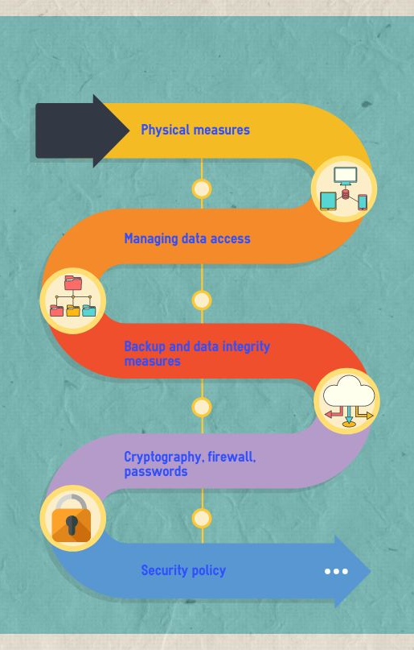
Security measures
Technical and organizational measures
Best practices of data governance
Considering the size of the organization, the budget available, the type of data
Assess the risks for data subject
Privacy by design – Privacy by default principles
Penetration tests
Regular audits

Slide 76
Risk assessment
Destruction
Loss
Unauthorized change
Unauthorized access
Unauthorized disclosure
Likelihood and impact

Slide 77
anonimyzation
ANONYMIZATION

Slide 78
ANONYMOUS, ANONIMIZED, PSEUDONYMIZED
Anonymous data: there were no identifying data in the first place
Anonymized data: identifying data were removed
Pseudonymized data: it is still possible to re-identify data using a key

Slide 79
Are anonymized data truly anonymized?
“In 2008, an anonymised Netflix dataset of film ratings was deanonymised by comparing the ratings with public scores on the IMDb film website in 2014; the home addresses of New York taxi drivers were uncovered from an anonymous data set of individual trips in the city; and an attempt by Australia’s health department to offer anonymous medical billing data could be reidentified by cross-referencing “mundane facts” such as the year of birth for older mothers and their children, or for mothers with many children.”
Read more at: 'Anonymised' data can never be totally anonymous, says study | Data protection | The Guardian

Slide 80
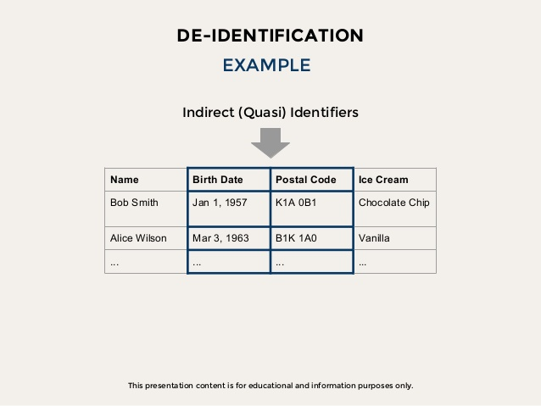
EXAMPLES
https://www.slideshare.net/mikenowakowski/data-privacy-anonymization-reidentification
K Anonimity: https://www.researchgate.net/figure/K-anonymized-Data-Set-k3_tbl1_281467551

Slide 81
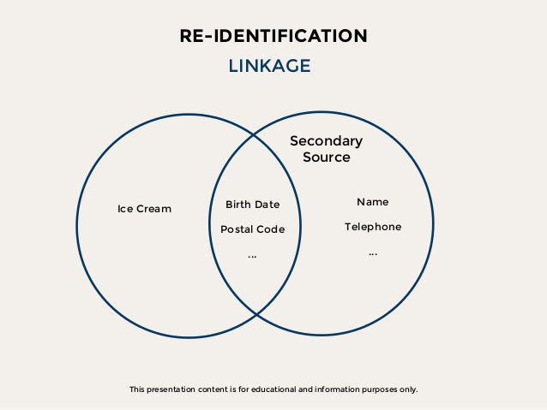
EXAMPLES

Slide 82
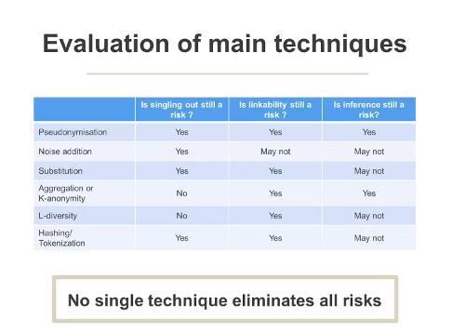
Anonymization tecniques
No singling out
No linkability
No inference
Source: LawSG-20180329 GDPR Dr Jambert Talk (panopto.eu)

Slide 83
CASE STUDIES
Are those data correctly anonymized?
Assigned ID | Gender | Year of birth (age) | Disease | Hospital | Date of admittance
A001 | F | 1979 | Renal calculi | Eindhoven | 19-03-2017
A002 | M | 1955 | Prostatic cancer | Eindhoven | 20-03-2017
A003 | M | 1955 | Prostatic cancer | Eindhoven | 18-06-2017
A004 | M | 1980 | Renal calculi | Eindhoven | 08-09-2017
A005 | F | 1980 | Renal calculi | Eindhoven | 01-12-2017
A006 | F | 1955 | Prostatic cancer | Eindhoven | 27-12-2017

Slide 85
CASE STUDIES
Are those data correctly anonymized?
Assigned ID | Gender | Year of birth (age) | Disease | Hospital | Date of admittance
A001 | F | 1979 | Renal calculi | Tilburg | 19-03-2017
A002 | M | 1955 | Prostatic cancer | Eindhoven | 19-03-2017
A003 | M | 1955 | Prostatic cancer | Helmond | 19-03-2017
A004 | M | 1980 | Renal calculi | Eindhoven | 01-12-2017
A005 | F | 1980 | Renal calculi | Eindhoven | 01-12-2017
A006 | F | 1955 | Prostatic cancer | Eindhoven | 01-12-2017
These data are not anonymous but pseudonymized. The hospital still retains the patients’ names, and it is possible to single out specific patients among the others. In this example, the last patient is clearly a trans woman.

Slide 86
4. THE NEW AI ACT PROPOSAL

Slide 87
What is considered AI in the new regulation?
Machine learning approaches, including supervised, unsupervised and reinforcement learning, using a wide variety of methods including deep learning
Logic- and knowledge-based approaches, including knowledge representation, inductive (logic) programming, knowledge bases, inference and deductive engines,(symbolic) reasoning and expert systems
Statistical approaches, Bayesian estimation, search and optimization methods

Slide 88
AMENDMENTS TO THE DEFINITION – Article 3
«‘artificial intelligence system’ (AI system) means a system that is designed to operate with elements of autonomy and that, based on machine and/or human-provided data and inputs, infers how to achieve a given set of objectives using machine learning and/or logic- and knowledge based approaches, and produces system-generated outputs such as content (generative AI systems), predictions, recommendations or decisions, influencing the environments with which the AI system interacts»

Slide 89
The protection of citizens’ rights
The most important innovation of the proposal is the establishment of four risks categories for AI systems, in order to protect citizens' fundamental rights. The explanatory memorandum attached to the proposal, in fact, notes that the use of AI with its specific characteristics (e.g. opacity, complexity, dependency on data, autonomous behaviour) can adversely affect a number of fundamental rights enshrined in the EU Charter of Fundamental Rights. The proposal seeks to ensure a high level of protection for those fundamental rights and aims to address various sources of risks through a clearly defined risk-based approach.

Slide 90
Classification of AI systems
The risk categories are related to the degree (intensity and scope) of risk for the safety or fundamental rights of citizens and are classified in three different groups:
(i) unacceptable risk
(ii) high risk
(iii) low or minimal risk
Taking inspiration from the product safety legislation, the classification of risks is based on the intended purpose and modalities for which the AI system is used, not only on their specific function. Depending on the national legal system, the qualification of high risk may have consequences over liability, such as that under art. 2050 of the Italian Civil Code.
(+1 = no risk)

Slide 91
Banned technology
Some AI systems are no longer allowed in the EU, with few exceptions, such as those that:
deploy subliminal techniques beyond a person’s consciousness in order to materially distort a person’s behaviour
exploit any of the vulnerabilities of a specific group of persons due to their age, physical or mental disability
Are used by the P.A. for the evaluation or classification of the trustworthiness of natural persons based on their social behaviour or their characteristics
use ‘real-time’ remote biometric identification systems in publicly accessible spaces for the purpose of law enforcement

Slide 92
Biometric identification systems for law enforcement
use ‘real-time’ remote biometric identification systems in publicly accessible spaces for the purpose of law enforcement: unacceptable risk
Remote biometric identification systems are defined as an AI systems ‘for the purpose of identifying natural persons at a distance through the comparison of a person’s biometric data with the biometric data contained in a reference database, and without prior knowledge of the user of the AI system whether the person will be present and can be identified’ (Article 3(36)).
The Proposal distinguishes ‘real-time’ and ‘post’ remote biometric identification. Real-time remote biometric identification systems are defined as AI systems ‘whereby the capturing of biometric data, the comparison and the identification all occur without a significant delay’. This definition introduces a mechanism to avoid circumvention, specifying that real-time remote biometric identification systems encompass both ‘instant identification’ and ‘limited short delays’ (Article 3(37)). Post remote biometric identification systems stand for any other type of remote identification system (Article 3(38)).

Slide 93
Real time identification
Only systems that fulfill these requirements are banned:
only ‘real-time’ remote biometric identification (not ex post identification)
systems used in publicly accessible spaces (not private spaces)
for the purpose of law enforcement (not other purposes)
There are also exceptions, including the search of victims, the prevention of threats to the life or safety of individuals, or the identification of a perpetrator or suspect of a criminal offense (punished with a minimum of 3 years of conviction), subject to a judicial review most of the time.

Slide 94
Biometric data
Data relating to the physical, physiological or behavioral characteristics of an individual which allow their unique identification, such as facial images or dactyloscopic data.
You need to be particularly careful when you handle this type of data

Slide 95
EDPB guidelines
Guidelines 3/2019 on videosurveillance
The intensive use of video devices has an impact on citizen’s behaviour. Significant implementation of such tools in many spheres of the individuals’ life will put an additional pressure on the individual to prevent the detection of what might be perceived as anomalies. De facto, these technologies may limit the possibilities of anonymous movement and anonymous use of services and generally limit the possibility of remaining unnoticed. Data protection implications are massive.

Slide 96
Risks of biometrical profiling
Privacy issues: intrusive facial recognition/ profiling of behaviours in public and private spaces. Video surveillance systems usually collect massive amounts of personal data which may reveal data of a highly personal nature and even special categories of data. Indeed, apparently non-significant data originally collected through video can be used to infer other information to achieve a different purpose (e.g. to map an individual’s habits). Biometric identification practices necessarily affect individuals who have no reason to be observed.
In addition to privacy issues, there are also risks related to possible malfunctions of these devices and the biases they may induce. Researchers report that software used for facial identification, recognition, or analysis performs differently based on the age, gender, and ethnicity of the person it’s identifying.
Algorithms would perform based on different demographics, thus, bias in facial recognition threatens to reinforce the prejudices of society. That is why, data controllers must also ensure that biometric data processing deriving from video surveillance be subject to regular assessment of its relevance and sufficiency of guarantees provided

Slide 97
Recital 33
«Technical inaccuracies of AI systems intended for the remote biometric identification of natural persons can lead to biased results and entail discriminatory effects. This is particularly relevant when it comes to age, ethnicity, race, sex or disabilities. Therefore, ‘real-time’ and ‘post’ remote biometric identification systems should be classified as high risk. In view of the risks that they pose, both types of remote biometric identification systems should be subject to specific requirements on logging capabilities and human oversight.»

Slide 98
What is bias?
The term bias is used by Friedman and Nissenbaum, who say it “refers to computer systems that systematically and unfairly discriminates against certain individuals or groups of individuals in favor of others”. By extension pre-existing societal bias is “bias that originates from society at large, such as from organizations (e.g., industry), institutions (e.g., legal systems), or culture at large. (E.g., gender biases present in the larger society that lead to the development of educational software that overall appeals more to boys than girls)”. Pre-existing bias can be implicit and subconscious, rather than malicious in intent.
Source: “Does Technology Have Race?’’, Hankerson et al, 2016

Slide 99
Examples

Slide 100
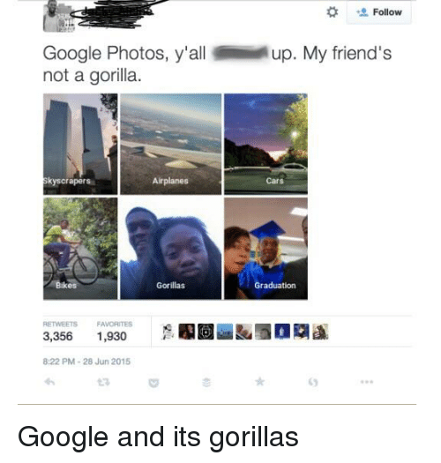
Examples

Slide 101
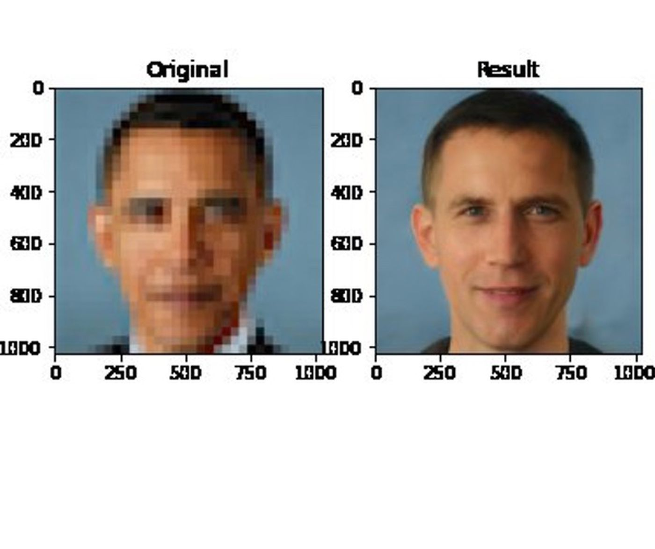
Examples

Slide 102
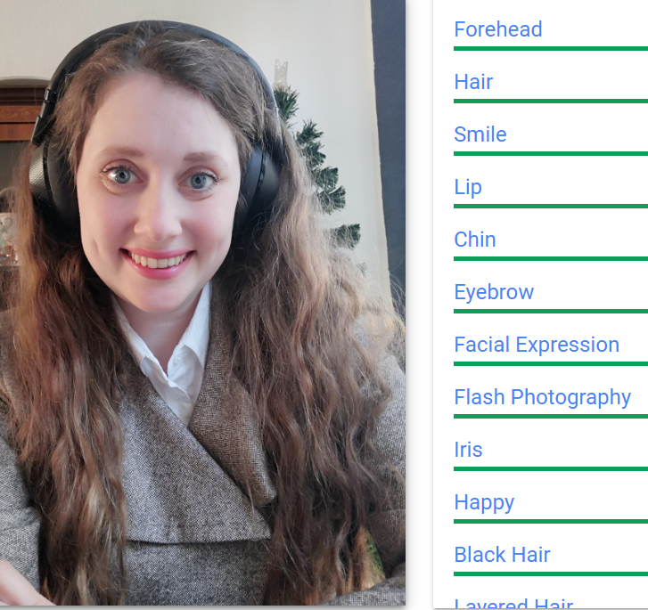
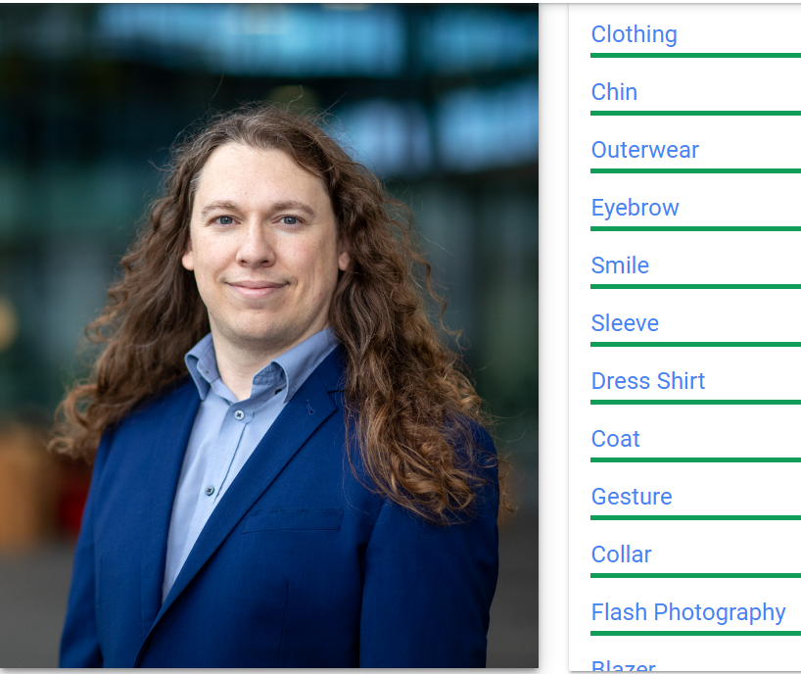
Examples

Slide 103
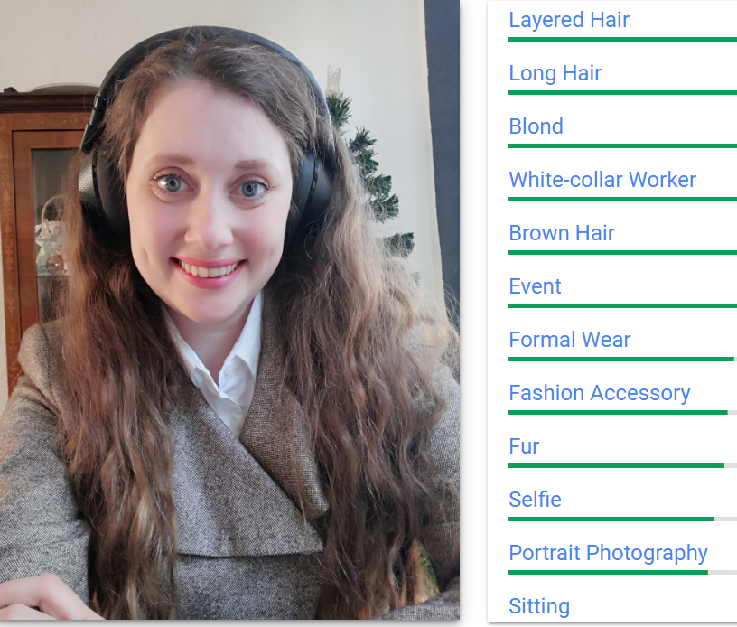
Examples

Slide 104
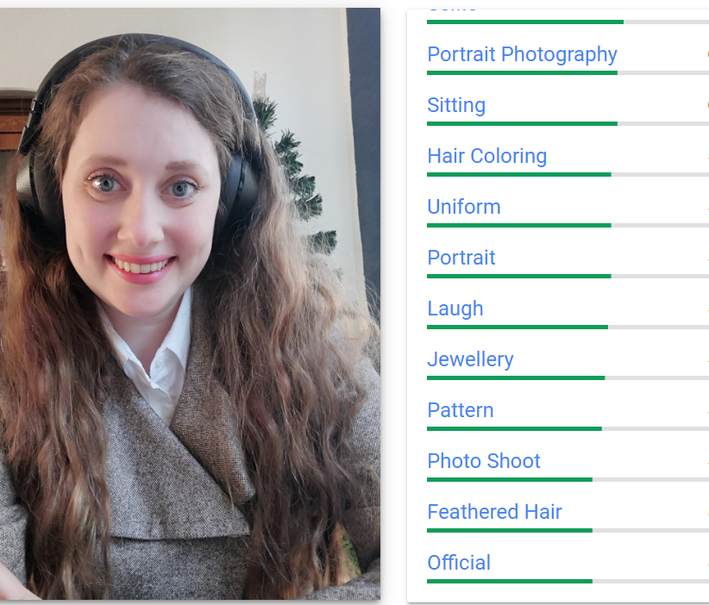
Examples

Slide 105
WHY DO WE CARE ABOUT BIAS?
1) Because it can lead to discrimination towards individuals or groups
2) Because it can lead to inaccurate results
3) Because it can cause errors and damage to people
4) Because it can cause negative effects on society

Slide 106
TYPES OF BIASES AND ERRORS IN DATA SETS & MODELS
Selection bias
Overfitting and underfitting the data
Reporting Biases
Overgeneralization Bias
Group Attribution Biases
Implicit Biases
Variance
Automation bias

Slide 107
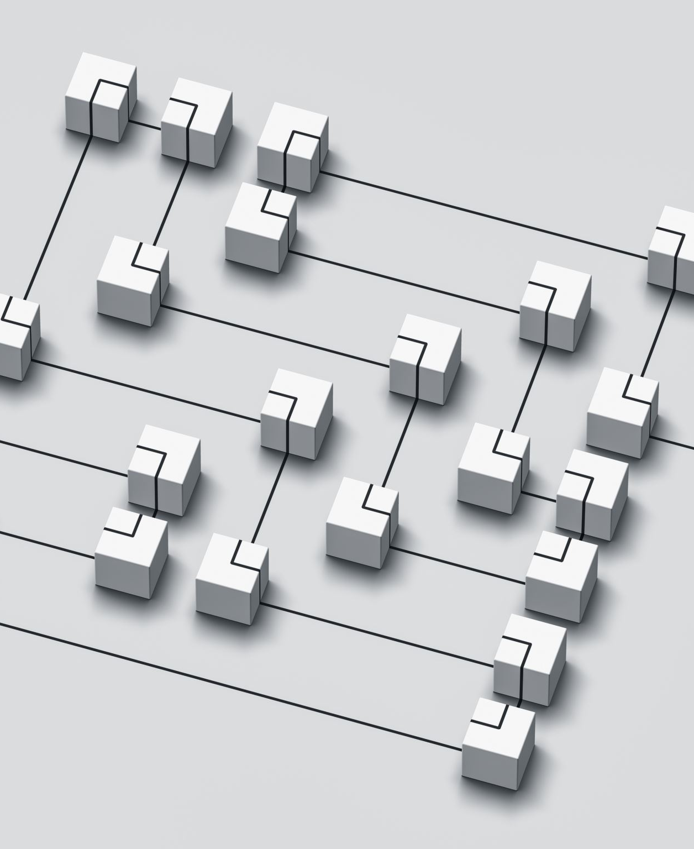
SELECTION BIAS
When data are selected in a way that is not representative of the distribution of data in real life, selection bias occurs. This occurs as a result of improper randomization during data collection.
When randomization is improperly achieved during data collection, sampling bias occurs.
When data are not chosen in a representative way, convergence bias occurs. For instance, your dataset does not accurately reflect the group of people who did not buy your goods if you just survey the half of your consumers who actually bought your product.
Participation bias is when there are gaps in involvement during the data collection process, making the data unrepresentative.

Slide 108
OVER- AND UNDER- FITTING
In machine learning, overfitting occurs when a model is trained with so much data that it begins to learn from the noise and inaccurate data entries in the data set. Machine learning models have trouble predicting new data based on the training data because what they learnt from the noise cannot be applied to new data.
When a machine learning model fails to capture the underlying trend of the data, underfitting occurs. In this case, it indicates that the model or algorithm is not fitting the data well enough.

Slide 109
REPORTING BIAS
The inclusion of only a portion of the results in an analysis, which often only includes a small portion of the evidence, is referred to as reporting bias, which can appear in many different ways.
Citation bias happens when your analysis is dependent on research that were included in other studies' citations.
When you disregard news sources that are not in your native tongue, you are exhibiting language bias.
When studies are given higher weight because they have been published more than once, this is known as duplicate publication bias.
Publication bias is the tendency for research with favorable results to be published more frequently than those with unfavorable outcomes or insufficient evidence.
Bias in the reporting of outcomes happens when some results are selectively reported. In a quarterly report, for instance, you only disclose when the company reports positive results.
Time lag bias is a problem when studies take a long time to be published.

Slide 110
OVERGENERALIZATION BIAS
Overgeneralization occurs when someone extrapolates from one occurrence to all subsequent events, thinking that what you observe in one dataset will also be observed in another.
It happens when you think that, regardless of the dataset's size, what you observe in your dataset is what you would also see if you looked in any other dataset intended to evaluate the same information.

Slide 111
GROUP ATTRIBUTION BIAS
Group attribution biases are the tendency for people to think that a group's beliefs always dictate an individual's traits or that a group's decisions are impacted by the emotions of all of its members.
.
When you favor those in a group to which you personally belong or have similar interests, you are exhibiting in-group bias.
When you stereotype certain members of a group to which you do not directly belong, this is known as out-group bias.

Slide 112
IMPLICIT BIAS
When assumptions are drawn from personal experiences that do not necessarily apply to more generic situations, implicit bias results. Without realizing it, people frequently act with bias and stereotypes in mind. Even when we are not aware of it, implicit bias takes the form of opinions and prejudices we have about other people. We could seek for information that confirms our assumptions and ideas while ignoring information that contradicts them.
We might associate, for instance, the white color to peace or purity. White, however, in Chinese and Japanese culture is associated to funerals.
The propensity to look for information in a way that supports or confirms one's preexisting opinions or experiences is known as confirmation bias or experimenter's bias.

Slide 113
VARIANCE
The variability in a model's prediction is known as variance. High variance models, in contrast to biased models, focus excessively on training data and fail to generalize to new data. On training data, this produces positive outcomes, but on test data, it produces high error rates. Variance can be thought of as the model's sensitivity to changes in the data. From noise, our model might learn. This will lead our model to value unimportant features highly. Low bias and low variance machine learning models are impossible to produce. However, you can try to make a tradeoff between the bias and the variance.

Slide 114
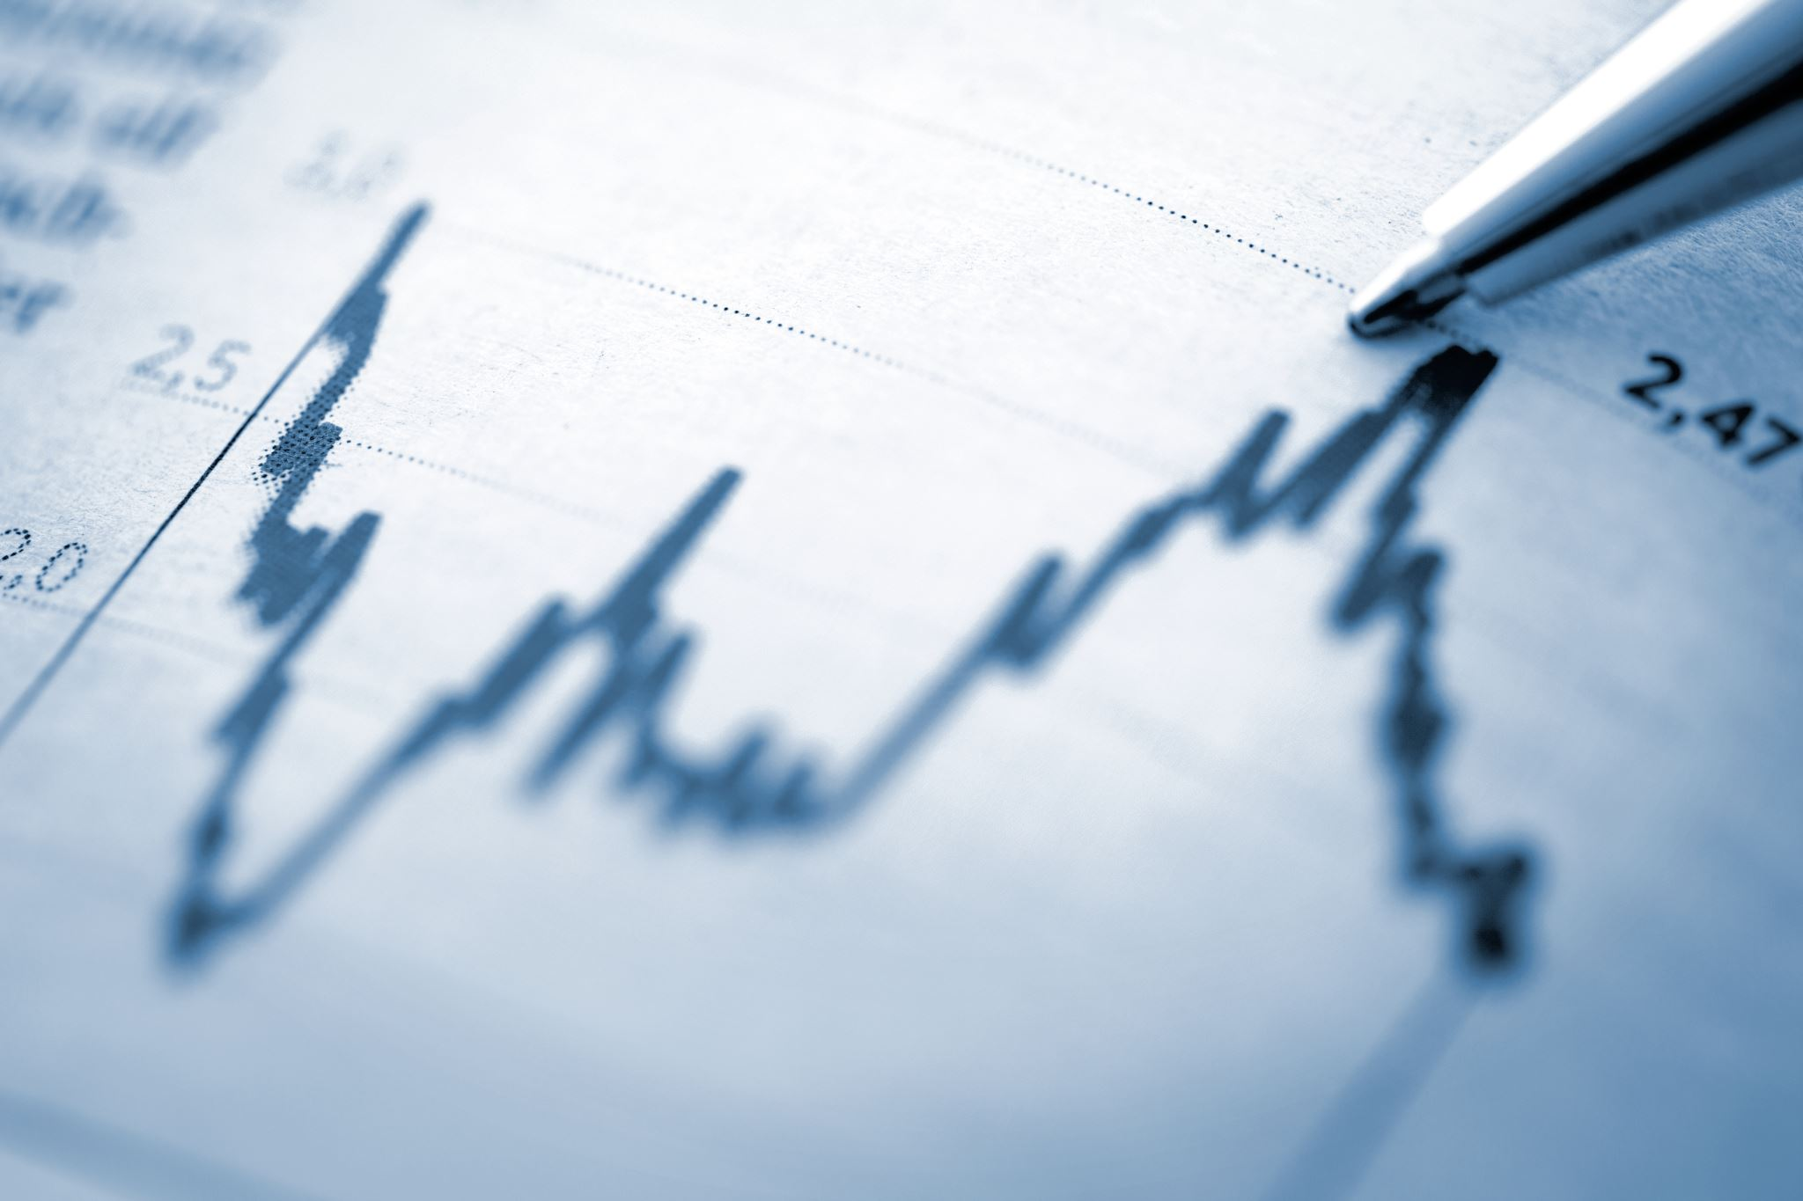
AUTOMATION BIAS
Automation bias is the propensity for people to favor outcomes or recommendations produced by automated systems and to discount contradictory data from non-automated systems, even when it is accurate. It happens when you act upon this AI-based recommendation without first checking to see if the data was accurate.
For instance, a data scientist relies on the analytics platform's advice to edit or eliminate specific data despite the platform's warnings, which lowers the data's quality.

Slide 115
BIAS IS AN IMPORTANT CONCEPT IN THE AI ACT – RECITAL 44
“High data quality is essential for the performance of many AI systems, especially when techniques involving the training of models are used, with a view to ensure that the high-risk AI system performs as intended and safely and it does not become the source of discrimination prohibited by Union law. High quality training, validation and testing data sets require the implementation of appropriate data governance and management practices. Training, validation and testing data sets should be sufficiently relevant, representative and have the appropriate statistical properties, including as regards the persons or groups of persons on which the high-risk AI system is intended to be used. These datasets should also be as free of errors and complete as possible in view of the intended purpose of the AI system, taking into account, in a proportionate manner, technical feasibility and state of the art, the availability of data and the implementation of appropriate risk management measures so that possible shortcomings of the datasets are duly addressed. The requirement for the datasets to be complete and free of errors should not affect the use of privacy-preserving techniques in the context of the development and testing of AI systems. Training, validation and testing data sets should take into account, to the extent required by their intended purpose, the features, characteristics or elements that are particular to the specific geographical, behavioural or functional setting or context within which the AI system is intended to be used. In order to protect the right of others from the discrimination that might result from the bias in AI systems, the providers should be able to process also special categories of personal data, as a matter of substantial public interest within the meaning of Article 9(2)(g) of Regulation (EU) 2016/679 and Article 10(2)g) of Regulation (EU) 2018/1725, in order to ensure the bias monitoring, detection and correction in relation to high-risk AI systems.”

Slide 116
The concept of ‘High Risk’
Some AI system are considered high risk and have to meet certain requirements before being released to the market or to the public. Some examples includes systems used in:
Machinery (including robots)
Toys
Medical devices
In Vitro Diagnostic
Vehicles
Aircrafts
Rails
AI Regulation must be coordinated with MDR, GDPR, and other laws (e.g., civil liability rules)

Slide 117
Other High Risk Systems
Biometric identification and categorisation of natural persons
Management and operation of critical infrastructure
Education and vocational training
Employment, workers management and access to self-employment
Access to and enjoyment of essential private services and public services and benefits
Law enforcement
Migration, asylum and border control management
Administration of Justice

Slide 118
Mandatory requirements for High Risk Systems
Risk management system:
identification and analysis of the known and foreseeable risks associated with each system
estimation and evaluation of the risks that may emerge when the system is used in accordance with its intended purpose and under conditions of reasonably foreseeable misuse
evaluation of other possibly arising risks based on the analysis of data gathered from the post-market monitoring system
adoption of suitable risk management measures

Slide 119
1. Risk Management System
Risk management measures
Identification and analysis of the known and foreseeable risks associated with each system during the whole lifecycle
Risks assessment related to the use
Estimation and evaluation of the risks that may emerge when the system is in use in accordance with its intended purpose and under conditions of reasonably foreseeable misuse
Post- market evaluation
Evaluation of other possibly arising risks based on the analysis of data gathered from the post-market monitoring system

Slide 120
Mandatory requirements for High Risk Systems
2. Data and data governance:
Training, validation and testing data sets concerning:
(a) the relevant design choices
(b) data collection
(c) relevant data preparation processing operations, such as annotation, labelling, cleaning, enrichment and aggregation
(d) the formulation of relevant assumptions, notably with respect to the information that the data are supposed to measure and represent
(e) a prior assessment of the availability, quantity and suitability of the data sets that are needed
(f) examination in view of possible biases
(g) the identification of any possible data gaps or shortcomings, and how those gaps and shortcomings can be addressed

Slide 121
Design
Design choices/ model choice
Collection
GDPR
Copyright
Preparing
Identification of gaps and shortcomings
Measures to fill and correct them
Gaps
Assumptions
Assessment
Biases
Re-use assessment
Annotation, labelling, cleaning, enrichment and aggregation of data
Information that the data are supposed to measure and represent
Availability, quantity and suitability of the data sets
Assessment for biases/discrimination
Privacy by design and by default
Testing if data are sufficient/ accurate
Testing if measures are effective
Testing to check if biases are present
Interpretable/Explainable AI
Features/variables
Data set validation
2. Data Management

Slide 122
ARTICLE 10
«To the extent that it is strictly necessary for the purposes of ensuring bias monitoring, detection and correction in relation to the high-risk AI systems, the providers of such systems may process special categories of personal data referred to in Article 9(1) of Regulation (EU) 2016/679 [GDPR], Article 10 of Directive (EU) 2016/680 [LED Directive] and Article 10(1) of Regulation (EU) 2018/1725 [Data protection for public bodies], subject to appropriate safeguards for the fundamental rights and freedoms of natural persons, including technical limitations on the re-use and use of state-of-the-art security and privacy-preserving measures, such as pseudonymisation, or encryption where anonymisation may significantly affect the purpose pursued.»

Slide 123
Mandatory requirements for High Risk Systems
3. Technical documentation:
Drawn before releasing the system
Demonstrate compliance with the requirements set out in the Regulation and provide national competent authorities and notified bodies with all the necessary information to assess the compliance with those requirements
Enabling the automatic recording of events (‘logs’) while the systems is operating

Slide 124
Mandatory requirements for High Risk Systems
5. Transparency and provision of information to users:
the identity and the contact details of the provider and, where applicable, of its authorised representative;
the characteristics, capabilities and limitations of performance of the system
the changes to the system and its performance which have been pre-determined by the provider at the moment of the initial conformity assessment, if any;
the human oversight measures, including the technical measures put in place to facilitate the interpretation of the outputs of systems by the users;
(e) the expected lifetime of the system and any necessary maintenance and care measures to ensure the proper functioning of that AI system, including as regards software updates

Slide 125
Mandatory requirements for High Risk Systems
6. Human oversight
Through measures:
identified and built into the system, when technically feasible, by the provider before it is placed on the market or put into service, and/or
(b) identified by the provider before placing the system on the market or putting it into service and that are appropriate to be implemented by the user

Slide 126
Mandatory requirements for High Risk Systems
7. Accuracy, robustness and cybersecurity:
Systems shall be resilient as regards errors, faults or inconsistencies that may occur within the system or the environment in which the system operates
The robustness of systems may be achieved through technical redundancy solutions, which may include backup or fail-safe plans
Systems shall be resilient as regards attempts by unauthorised third parties to alter their use or performance by exploiting the system vulnerabilities
The technical solutions to address AI specific vulnerabilities shall include, where appropriate, measures to prevent and control for attacks trying to manipulate the training dataset (‘data poisoning’), inputs designed to cause the model to make a mistake (‘adversarial examples’), or model flaws

Slide 127
RECITAL 50
“The technical robustness is a key requirement for high-risk AI systems. They should be resilient in relation to harmful or otherwise undesirable behaviour that may result from limitations within the systems or the environment in which the systems operate (e.g. errors, faults, inconsistencies, unexpected situations). High-risk AI systems should therefore be designed and developed with appropriate technical solutions to prevent or minimize that harmful or otherwise undesirable behaviour, such as for instance mechanisms enabling the system to safely interrupt its operation (fail-safe plans) in the presence of certain anomalies or when operation takes place outside certain predetermined boundaries. Failure to protect against these risks could lead to safety impacts or negatively affect the fundamental rights, for example due to erroneous decisions or wrong or biased outputs generated by the AI system”

Slide 128
ARTICLE 15
«High-risk AI systems that continue to learn after being placed on the market or put into service shall be developed in such a way to eliminate or reduce as far as possible the risk of possibly biased outputs influencing input for future operations (‘feedback loops’) are duly addressed with appropriate mitigation measures.»

Slide 129
Mandatory requirements for High Risk Systems
8. Quality management system:
a strategy for regulatory compliance
techniques, procedures and systematic actions for the design, design control and design verification of the system
techniques, procedures and systematic actions for the development, quality control and quality assurance of the system
examination, test and validation procedures
technical specifications, including standards, to be applied
systems and procedures for data management, including data collection, data analysis, data labelling, data storage, data filtration, data mining, data aggregation, data retention and any other operation regarding the data that is performed before - and for the purposes of - the placing on the market or putting into service of the systems (see n. 2)

Slide 130
Mandatory requirements for High Risk Systems
8. Quality management system:
the setting-up, implementation and maintenance of a post-market monitoring system
procedures related to the reporting of serious incidents and malfunctioning
the handling of communication with competent authorities, including sectoral ones, providing or supporting the access to data, notified bodies, other operators, customers or other interested parties
systems and procedures for record keeping of all relevant documentation and information
resource management, including security of supply related measures
an accountability framework setting out the responsibilities of the management and other staff with regard to all aspects listed in this paragraph
9. Providers shall draw up technical documentation required by the Regulation

Slide 131
Transparency obligations for certain AI systems
Providers shall ensure that AI systems intended to interact with natural persons are designed and developed in such a way that natural persons are informed that they are interacting with an AI system, unless this is obvious from the circumstances and the context of the use
Users of an AI system that generates or manipulates image, audio or video content that appreciably resembles existing persons, objects, places or other entities or events and would falsely appear to a person to be authentic or truthful (‘deep fake’), shall disclose that the content has been artificially generated or manipulated

Slide 132
2. BASIC PRINCIPLES OF AI AUDITING

Slide 133
What is AI auditing?
AI Auditing is the review of the whole AI lifecycle, including the post-market phase, with the aim of identifying and addressing risks for citizens and the society. It is carried out through applying legal, ethical and technical principles in practice.
«An ethics-based auditing can improve the quality of decision making,
increase user satisfaction, unlock growth potential, enable law-making, and
relieve human suffering»
- Mokander & Floridi

Slide 134
How to perform AI auditing?
An AI Audit is carried out through the practical implementation of several principles:
Ethics: checking if the consequences on individuals and society have been taken into account
Human Rights: checking if fundamental rights of citizens are respected
Law: checking if legal compliance has been performed (privacy, cybersecurity, national laws, etc.)
Technical good practices: checking if the system is sound, safe, secure, correct, and biasless (e.g.: avoid sample bias)

Slide 135
Guidance to perform AI auditing
In the literature, several authors have proposed a method to perform an AI audit, but few have shown how to do it in practice.
Most papers focuses on the technical aspects, such as debiasing techniques and data set balancing.
Floridi et al. suggest a guide to implement the new AI Act requirements in its paper «CapAI»

Slide 136
3. BASIC PRINCIPLES OF AI ETHICS

Slide 137
What is AI Ethics?
AI Ethics is a branch of Philosophy; it studies the ethical principles applicable to AI systems and addresses the implications, risks and problems derived from:
humans building and employing those systems, and
the behavior of autonomous systems

Slide 138
Most famous ethics guidelines
Universal Guidelines for AI (2018)
OECD AI Principles (2019)
G20 AI Guidelines (2019)
UNESCO Recommendation on AI Ethics (2021)

Slide 139
Ethical principles
Jobin, Anna, Marcello Ienca, and Effy Vayena. "The global landscape of AI ethics guidelines." Nature Machine Intelligence 1.9 (2019): 389-399.

Slide 140
Trustworthy AI
AI HLEG recognizes 3 keys elements of Trusworthy AI:
1. it should be lawful, complying with all applicable laws and regulations;
2. it should be ethical, ensuring adherence to ethical principles and values; and
3. it should be robust, both from a technical and social perspective, since, even with good intentions, AI systems can cause unintentional harm.

Slide 141
The ALTAI List
AI HLEG has drawn a list of 7 elements:

Slide 142
Open Ethics Canvas
This instrument is used by several companies in order to perform an ethical assessment of their AI systems
Green: non-technical ethics
Grey: technical ethical assessment
Yellow: accountability and human oversight
Red: legal assessment and societal liability

Slide 143
4. APPLYING ETHICAL PRINCIPLES TO DATA SETS:
A PRACTICAL EXAMPLE

Slide 144
Preliminary remarks
An AI system is only as good as the data it relies on.
Garbage in = garbage out
Data sets can be unbalanced, biased, incomplete, too small, inadequate for the intended use, not clean and not validated.
It is extremely important to prepare data before feeding it to the AI model.

Slide 145
Applying ethical and legal principles in practice
Data Collection
Data preparation
Data utilization
Non-discrimination
Fairness
Transparency
Privacy
Copyright
Accountability
Risk management
Quality assessment
Data Governance
AI MODEL
TRAINING

Slide 146
How to apply those principles in practice?
?
?
?
?
?
?
助けて！

Slide 147
Developing AI models for hearing aids
We are working on a project to develop an AI model to help people with hearing impairments
The goal is to help them hear better and understand what it is said in a conversation, so the model needs to be able to recognize all kind of voices in all settings
People with hearing impairments have the right not to be excluded in a conversation
People with speech impairments, with a different accent or pronunciation, with a low/high tone of voice, or that are slow in talking, have the right to have their voice recognized

Slide 148
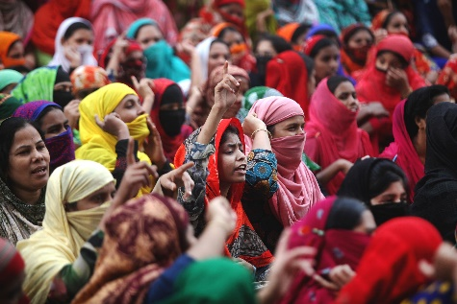
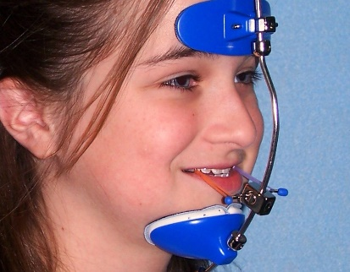
What could go wrong?
If the data set is biased and different categories of people are not represented, this could lead to discrimination towards both people with hearing impairments and underrepresented groups, as the model will not be able to recognize all voices

Slide 149
Mozilla Common Voice Data Set
Intended use?
Type of data?
Model choice?
Validation info
Type of license
Number of examples
Age and gender composition

Slide 150
Terms & Conditions
Privacy

Slide 151
Looking into the data set metadata

Slide 152
Looking into the data set metadata
Are all relevant metadata present?
How can you fill the missing data?

Slide 153
Looking into the data set metadata
Individual identifier
=
Not anonymous
Beware of linking risk

Slide 154
Looking into the data set metadata
How is validation performed?
Does it match the intended use?
Is it fair or could it lead to biases?
Should I provide an alternative validation?

Slide 155
Looking into the data set metadata
What accents are present?
Are foreigners and vulnerable groups represented?

Slide 156
Looking into the data set metadata
Are different age and gender types equally represented?
Could an imbalance lead to discrimination?

Slide 157
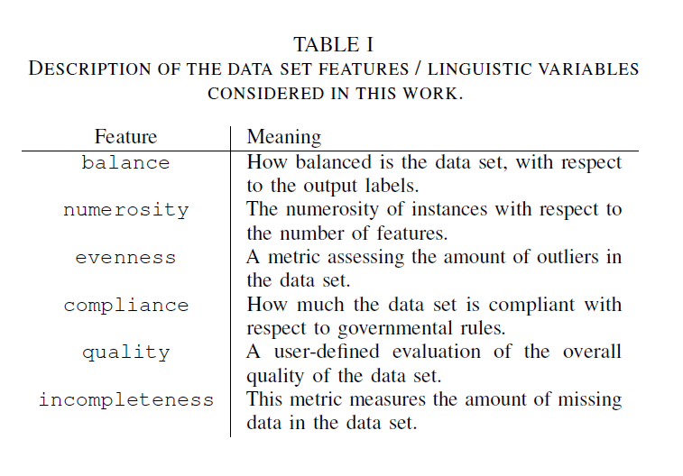
FANFAIR FUZZY LOGIC ASSESSMENT
In order to assess the potential fairness of a data set, we identified six different elements that should be addressed before employing the data set. To identify each criteria, we were inspired by general principle of civil law and EU law, and established ethics guidelines.

Slide 158
BALANCE
A data set can be defined as “balanced” if all classes are well represented in the data set. The importance of balance is described in a wealth of literature: an unbalanced data set may produce biased models, unable to generalise and with prejudicial effects on single individuals or entire categories of individuals, such as disparity in accuracy.
For example, if a data set, which is used to train a model aimed at classifying patients in healthy or non-healthy, contains thousands of examples of non-healthy patients and only a few example of healthy individuals, the model will probably be unable to recognise healthy individuals with high accuracy. It is therefore crucial to have a similar number of examples in each class.

Slide 159
NUMEROSITY
This data set feature refers to the quantity of instances normalised by the number of features in the data set. The quantity is important in order to mitigate possible biases in the model output: a model with a low number of examples will not be able to generalise.
To show an example of why this can happen, consider the situation in which all the features have no relation with the outputs to be predicted. In that case, we would like to have a machine learning algorithm to be unable to perform well since there is actually no relation with the between the inputs and the outputs: any learned relation will be purely the effect of chance, it will not be representative of the phenomenon being modelled and will clearly be unable to generalise.
A widespread rule of thumb of machine learning suggests that an optimal number of instances S would be 10 × D.

Slide 160
NUMEROSITY of what?
Sometimes the quantity of instances normalised by the number of features in the data set is high, because multiple samples were collected from a single person. In this case, depending on the problem and the purpose of our model, numerosity might still not be enough to have a reliable output and we might need to collect samples from multiple persons.
It is important to talk with the domain expert to understand if this is the case.

Slide 161
UNEVENNESS
This feature refers to the number of outliers in the examples. If a value is very different from all other values in the data set, it is important to understand why this occurs. For example, in a data set made of physiological values of non-healthy patients, in the weight column we could find abnormal values (too high or too low).
The domain expert will certainly understand that an adult individual cannot have a weight of 100 grams or of 20000 kilograms, and therefore there is an error in the data collection. However, outliers might sometimes be just individuals with unique features with respect to the average, such as a patient with a weight over 600 kilograms. In this case, there is a risk of singling out and the patient’s identity will likely be recognized if the data set is released to the public.
It is important to note that outliers are not useful for the model, since they refers to particular cases which might better be assessed individually by the domain expert instead of by an automatic mean such as an AI model. The model will not be able to generalise and give an accurate output for outliers’ cases. Instead, it would be more useful to create a different model specifically calibrated to individuals who present abnormal values.

Slide 162
QUALITY
This feature refers to the quality of data as assessed by the domain expert (such as if an image is clear or complete, or if the sound can be recognised in a recording). The domain expert will make an assessment about the quality of the data set, based on the state of the art in the specific field (such as medical imaging) and on the needs related to each specific model.
This step is needed because the data collection is often performed by different people without direct supervision (e.g., nurses, young medical trainees, students, etc.), therefore errors in acquiring clear data may occur.
Do not use a data set to train models employed in critical applications (e.g., clinical decisions) if a domain expert has not validated the quality of the data.

Slide 163
INCOMPLETENESS
This feature refers to “holes” in the data set regarding relevant elements, such as missing information about a patient in one or more physiological values. When this circumstance occurs, it is necessary to exploit imputation techniques or to discard the patient from the data set altogether, if too little information is provided. There are three possible types of incomplete data sets:
1) some variables (e.g., dataframe columns) may have missing values. For instance, this might happen when the variable is related to some exam that is only administered to very specific patients;
2) some instances (e.g., dataframe rows) may have missing values. For instance, this might happen to fragile patients that cannot undergo some treatments or exams;
3) finally, the holes can be randomly distributed across all variables and instances of the data sets.

Slide 164
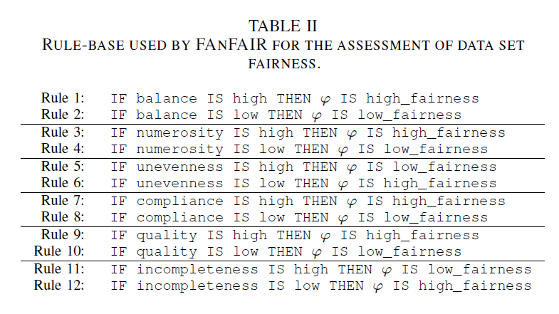
RESULTS OF FANFAIR
These variables represent important characteristics that are automatically extracted by the data set or (in the case of compliance and quality) are entered by the user. FAnFAIR returns a summary of the contribution of all variables to the final fairness value. The contributions are expressed both in fuzzy terms (e.g., “compliance is fairly high”) and by using a visual plot. The final fairness value is calculated as a value between 0 (totally unfair) and 1 (maximum theoretical fairness).

Slide 165
Existing techniques (pros & cons)
Select a statistically significant sample and check it manually
Over- or under-sampling
Make your testing data set balanced
Use automated techniques, e.g., automated gender recognition, to fill the gaps in metadata
Use multiple data sets and combine them
Collect new data to integrate missing data
Use data augmentation and/or synthetic data
Pre-process your data to add noise or other relevant elements
Compare your model output with that of different models in different settings

Slide 166
DATA SET BALANCING
If there is a severe imbalance and the dataset is tiny (or high dimensional, etc.), which is frequently the situation in clinical data sets, imbalance could be problematic. Having unbalanced data can be an issue depending on the application's objectives.
For instance, if you want to forecast a given outcome and your data shows that A occurs 99.99% of the time and B occurs 0.01% of the time, your algorithm would likely always suggest A. However, in many cases, we are more curious about why B occurs on occasion than we are about whether the prediction was accurate. We might be interested in good performance on a minority class. Unbalanced data, therefore, becomes a concern. The technique you used is appropriate, but not for your question.
See: https://stats.stackexchange.com/questions/283170/when-is-unbalanced-data-really-a-problem-in-machine-learning

Slide 167
HOW DO WE SOLVE DATA SET UNBALANCE?
Baseline Methods
Random over-sampling
Random under-sampling
Under-sampling Methods
Tomek links
Condensed Nearest Neighbor Rule
One-sided selection
CNN + Tomek links
Neighborhood Cleaning Rule
Over-sampling Methods
Smote
Combination of Over-sampling method with Under-sampling method
Smote + Tomek links
Smote + ENN
Source: A Study of the Behavior of Several Methods for Balancing Machine Learning Training Data Author: Gustavo E. A. Batista Presenter: Hui Li University of Ottawa.

Slide 168
OVERSAMPLING AND UNDERSAMPLING
You shouldn't over-sample the test set, only the training test
Source: https://medium.com/towards-data-science/handling-imbalanced-datasets-in-deep-learning-f48407a0e758

Slide 169
DATA AUGMENTATION
It is a set of techniques that expand the available dataset without actually collecting new elements: data augmentation applies controlled random changes to existing data, making modified copies of it, in order to reduce overfitting.
Like all techniques, it can introduce biases.

Slide 170
IMPUTATION
Imputation techniques "guess" realistic values that are used to replace missing values (“holes”) in a dataset. The model guesses data by assuming that they are similar to the ones that already are present in the data set, which is going to reinforce any pattern that might be in the data, potentially turning a non-significant pattern into a significant one and thus introducing biases.
Example: Missing data can substantially affect the precision of estimated change in patients reported outcomes scores from clinical registry data. Inclusion of auxiliary information in Multiple Imputation models can increase precision and reduce bias, but identifying the optimal auxiliary variable(s) may be challenging.
(Ayilara, O.F., Zhang, L., Sajobi, T.T. et al. Impact of missing data on bias and precision when estimating change in patient-reported outcomes from a clinical registry. Health Qual Life Outcomes 17, 106 (2019). https://doi.org/10.1186/s12955-019-1181-2)

Slide 171
SYNTETHIC DATA
Synthetic data is information that's artificially created, it is not collected or generated by real-world events or persons. Generally, it is created by algorithms, but of course it can be generated by hand as well
Synthetic data and original data should deliver very similar results when undergoing the same statistical analysis
It has the benefit to protect privacy, as real personal data can be avoided. A privacy assurance assessment should be performed to ensure that the resulting synthetic data is not actual personal data, evaluating the extent to which data subjects can be identified in the synthetic data and how much new data about those data subjects would be revealed upon successful identification
It might contribute to mitigate bias by using fair synthetic datasets to train artificial intelligence models, manipulated to have a better representativeness of the world
The quality of synthetic data is highly correlated with the quality of the original data and the data generation model. Synthetic data may reflect the biases in original data. Also, the manipulation of datasets to create fair synthetic datasets might result in inaccurate data

Slide 172
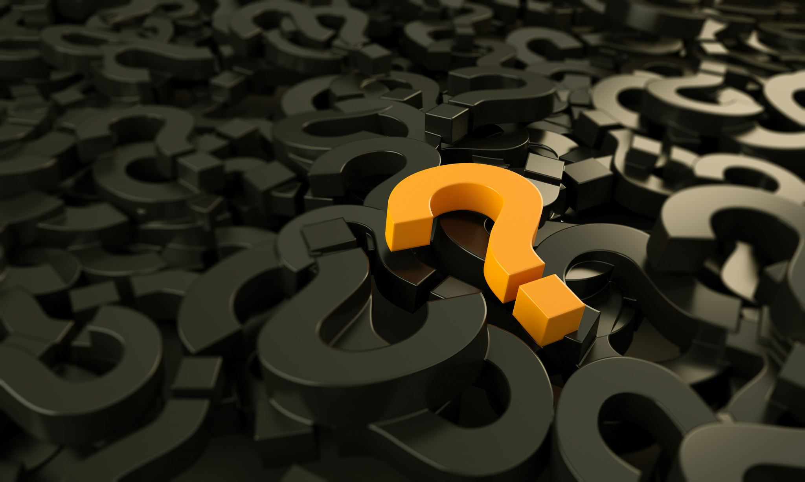
Any question?
c.g.gallese.nobile@tue.nl

Slide 173
Credits
Images and videos in this presentation are used under fair use for educational purposes.
They belong to/were found in:
Pixabay
Microsoft
Slidego
Data Protection Network
OM Data Consulting
Shutterstock
johnchow.com
inbusiness.kz
Avito.ru
medium.com
million-wallpapers.ru
www.flickr.com/people/tim2k

